Slide 1
Applications of DNS
Understanding the Role of Domain Name System in Networking

Slide 2
Applications of DNS
Web Browsing: Resolves domain names to IP addresses.
Email Services: Used in mail exchange (MX) records.
CDNs: Helps in delivering content efficiently by directing users to the nearest servers.
Load Balancing: Distributes network traffic across multiple servers.
Security: DNS filtering, DNSSEC for integrity, and protection against phishing.

Slide 3
Future of DNS
Enhanced security with DNS over HTTPS (DoH) and DNS over TLS (DoT).
Growing role in IoT and cloud computing.
AI-driven DNS optimization for better performance.

Slide 4
Why is DNS Important?
Simplifies Access → Users can type example.com instead of memorizing 192.168.1.1.
Scalability → Supports billions of devices worldwide.
Load Balancing → Distributes traffic across multiple servers.
Security Features → Uses DNSSEC to prevent spoofing and phishing attacks.

Slide 5
DNS Security Issues & Solutions
The Domain Name System (DNS) is essential for internet communication, but it has security vulnerabilities that attackers can exploit. Below are some common DNS threats and their solutions.

Slide 6
Common DNS Security Issues
DNS Spoofing (DNS Cache Poisoning)
Attackers inject false DNS records into a resolver’s cache, redirecting users to malicious sites.
Example: You type bank.com, but due to poisoning, it takes you to a phishing page.
DDoS Attacks (Distributed Denial of Service)
Attackers overwhelm DNS servers with massive traffic, making websites inaccessible.
Example: Botnets flood DNS servers with fake requests, causing downtime.
DNS Hijacking
Attackers modify DNS settings to redirect users to malicious servers.
Example: Your ISP or malware changes your DNS settings to serve ads or steal data.

Slide 7
DNS Spoofing (DNS Cache Poisoning)
What is it?
Attackers inject false DNS records into a resolver’s cache, tricking users into visiting malicious websites instead of the intended destination.
How it works:
The attacker sends fake DNS responses to a resolver before it gets a legitimate response.
These fake records are stored in the cache, leading users to a phishing or malware-infected site.
Example:
You type bank.com, expecting to reach your bank’s website.
Due to cache poisoning, your browser is redirected to a fraudulent page that looks identical to the real site.
If you enter your credentials, hackers can steal your login details.
Impact:
Phishing attacks, credential theft, financial fraud.

Slide 8
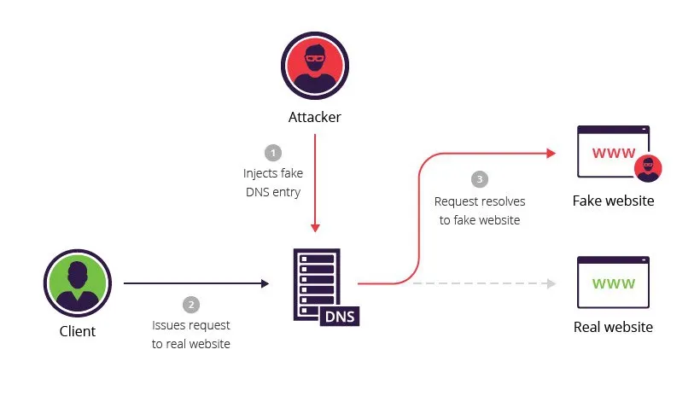

Slide 9
2. DDoS Attacks (Distributed Denial of Service
What is it?
Attackers flood DNS servers with an overwhelming number of queries, causing slowdowns or making websites completely inaccessible.
How it works:
A botnet (a network of compromised computers) sends massive amounts of fake DNS requests to a target server.
The DNS resolver gets overloaded and fails to respond to legitimate users.
Example:
A botnet sends millions of fake DNS queries to a major DNS provider (e.g., Cloudflare, Google).
The provider's servers struggle to respond, making many websites unreachable.
Impact:
Website downtime, loss of revenue, degraded performance.

Slide 10
3. DNS Hijacking
What is it?
Attackers modify DNS settings to redirect users to malicious sites or inject ads into their browsing experience. This can be done by malware or even rogue ISPs.
How it works:
Malware changes a user’s DNS settings, making all internet traffic go through a malicious server.
A rogue ISP may redirect traffic to advertisement pages for profit.
Example:
You type facebook.com, expecting the real site.
Your hijacked DNS redirects you to a fake login page that steals your credentials.
Impact:
Identity theft, ad injection, surveillance, data theft.

Slide 11
Solutions to These DNS Attacks
To mitigate these threats, organizations and individuals can implement security measures like:
DNSSEC (Domain Name System Security Extensions) – Uses digital signatures to verify DNS responses and prevent spoofing.
Use Trusted DNS Resolvers – Google Public DNS (8.8.8.8), Cloudflare (1.1.1.1), OpenDNS.
DNS Over HTTPS (DoH) & DNS Over TLS (DoT) – Encrypts DNS queries to prevent interception.
Rate Limiting & Anomaly Detection – Helps mitigate DDoS and NXDOMAIN attacks.
Firewall & Network Monitoring – Detects suspicious activity and prevents unauthorized changes.

